Slide 1


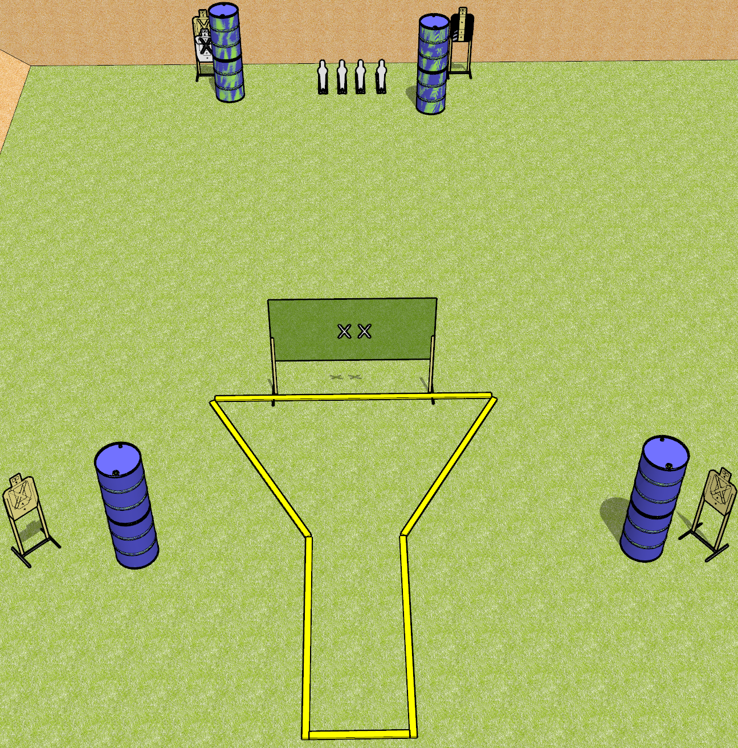
 | Dothan Gun Club – USPSA Match Beaker Course Designer : Drew Coleman
START POSITION : Hands touching both X’s. PCC muzzle touching either X
GUN READY CONDITION : Pistol has loaded magazine inserted with an empty chamber, hammer down. PCC has loaded magazine inserted with an empty chamber, safety on, shouldered, held with box hands, muzzle touching either X. |  | SCORING: Comstock, 12 rounds TARGETS: 4 paper, 4 Steel SCORED HITS: Best 2 on paper, steel until down START-STOP: Audible, last shot RULES:
STAGE PROCEDURE: Engage targets as they become available from within the fault lines.

Slide 2
Beaker
Written Stage Briefing
Beaker is a 12 round, 60 point, Comstock short course. There are 4 USPSA targets and four USPSA mini poppers. The best two hits on paper will score, and steel must fall to score. The start signal is audible.
Handgun start position is both hands touching X’s. Handgun has loaded magazine inserted with an empty chamber, hammer down.
PCC start position is muzzle touching either X. Loaded magazine is inserted with an empty chamber, safety on. PCC is shouldered, held with both hands.
Stage Procedure

